Slide 1
Data and Computer Communications
Chapter 5 – Signal Encoding Techniques
Ninth Edition
by William Stallings

Slide 2
Major 4 Encoding Methods
Digital Data
To
Digital Signal
Digital Data
To
Analog Signal
Analog Data
To
Digital Signal
Analog Data
To
Analog Signal

Slide 3
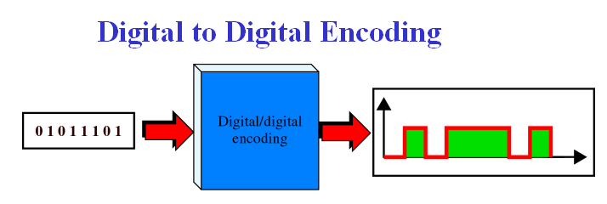
Digital to Digital Conversion
Converting binary 0’s and 1’s into a sequence of voltage pulses that can propagate over a wire.

Slide 4
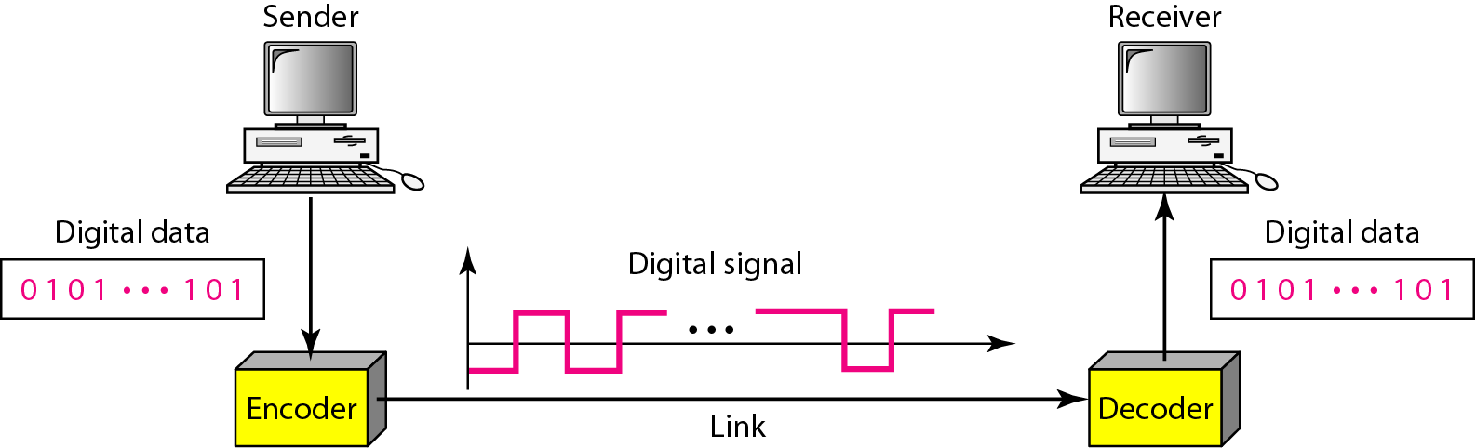
Line Coding and Decoding

Slide 5
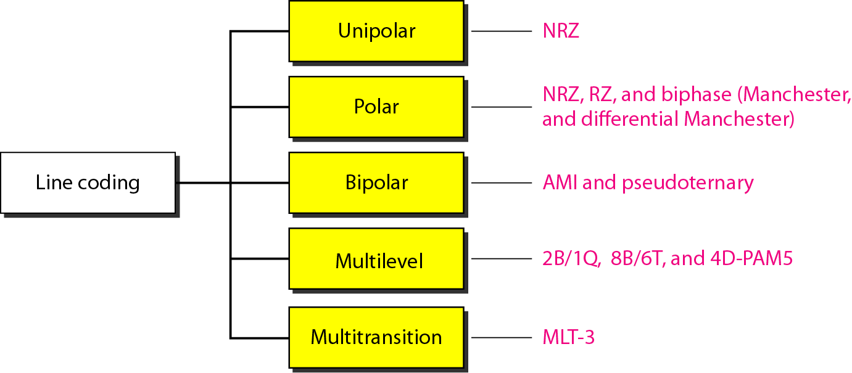
Line Coding

Slide 6
Line Coding
unipolar – all signal elements have the same sign
polar – one logic state represented by positive voltage and the other by negative voltage
Bipolar – three voltage levels: positive, zero, and negative

Slide 7
DC components
Some coding schemes have a residual DC [Direct-Current] that has a zero frequency. The positive and negative voltages do not cancel each other.
Not Desirable
This extra energy on the line is useless and will not pass properly through Transformers! Bad!
직류성분을 다룰 수 없는 매체는 통과 불가능
Capacitive Coupling

Slide 8
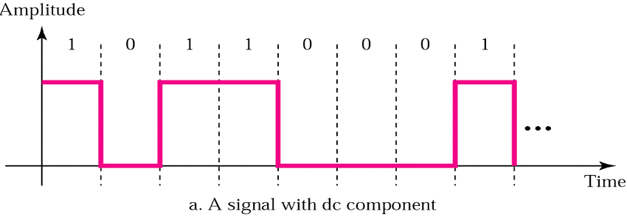
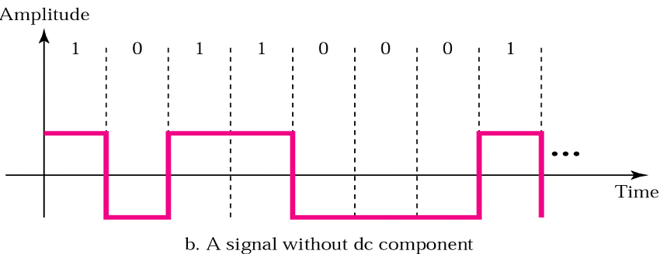
DC components

Slide 9
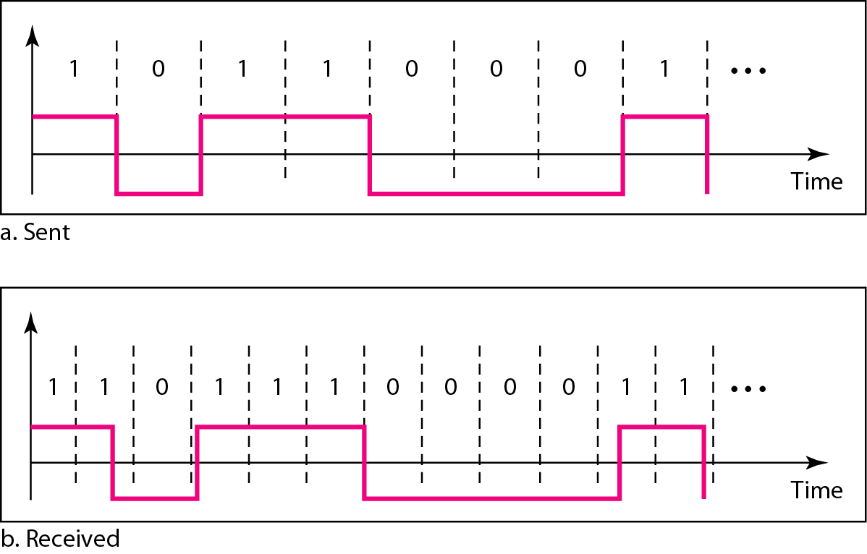
Synchronization
To interpret the received signal correctly, the bit interval of the receiver should be exactly same or within certain limit of that of the transmitter.
Any mismatch between the two may lead wrong interpretation of the received signal.

Slide 10
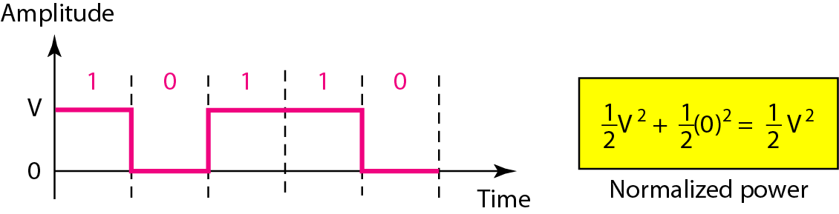
Unipolar
the polarity is assigned to ‘1’ bit, while the ‘0’ bit is represented by zero voltage.
use one voltage level

Slide 11
Unipolar
Unipolar requires DC component
Average amplitude is non-zero
Not all mediums can handle a DC component
Unipolar requires synchronization
No way receiver can determine beginning or end
Problem with a long, uninterrupted series of 1’s or 0’s
Solution to synchronization problem
Use a separate parallel line to carry clock pulse
Doubling # lines expensive

Slide 12
Polar
Two voltage levels
0 - positive & 1 – negative
or vice versa
Average amplitude is 0
DC component not needed

Slide 13
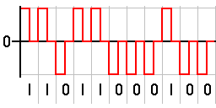
Return to Zero (RZ)
Return to Zero (RZ) uses three values: positive, negative and zero. In RZ, the signal changes not between bits but during (middle of) each bit.
A 1 bit is represented by positive-to-zero and a 0 bit by negative-to-zero.
The main disadvantage of RZ is that it requires two signal changes to encode one bit and therefore occupies more bandwidth.

Slide 14
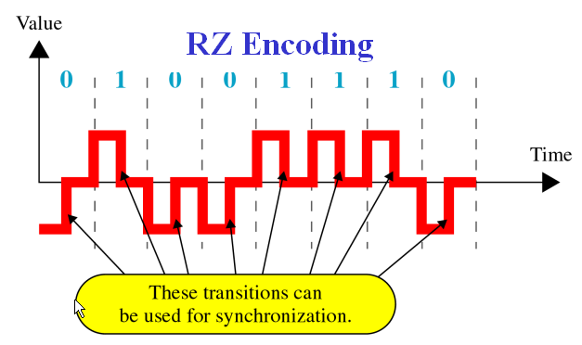
Return to Zero (RZ)
3 levels of amplitude – 3 voltage levels
A signal change with every bit to assure synchronization

Slide 15
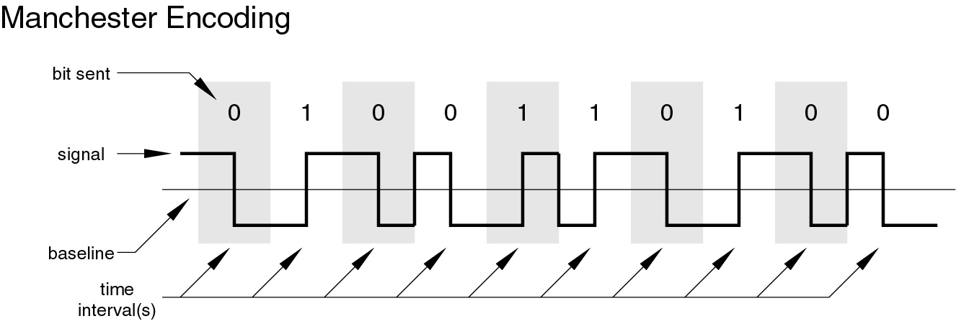
Manchester Encoding
transition in middle of each bit period
midbit transition serves as synchronization and data (bit representation)
low to high transition : 1
high to low transition : 0
used by IEEE 802.3 (LAN)

Slide 16
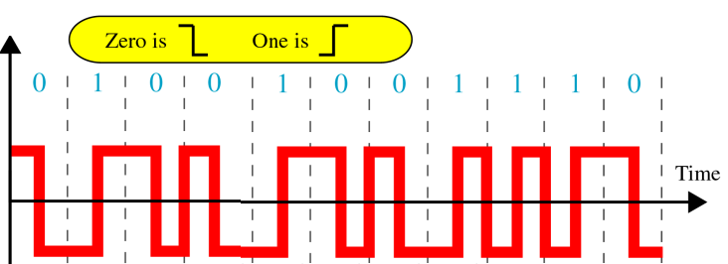
Manchester Encoding
Two levels of amplitude
Same synchronization as RZ
Example

Slide 17
Bipolar
three voltage levels: positive, zero, and negative.
The zero level is used to represent binary 0.
The 1s are represented by alternating positive and negative voltages (even if the 1 bits are not consecutive).
A common bipolar encoding scheme is called Alternate Mark Inversion (AMI). The word mark comes from telegraphy and it means 1.

Slide 18
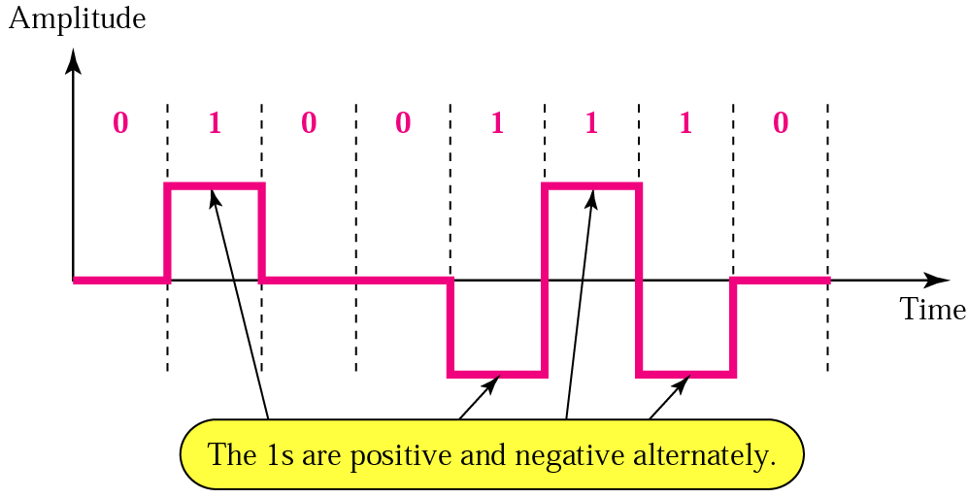
Bipolar AMI Encoding

Slide 19
Major 4 Encoding Methods
Digital Data
To
Digital Signal
Digital Data
To
Analog Signal
Analog Data
To
Digital Signal
Analog Data
To
Analog Signal

Slide 20
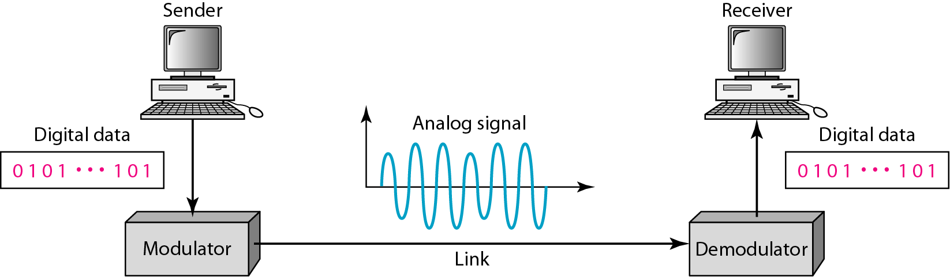
Digital Data, Analog Signal

Slide 21
Digital Data, Analog Signal
반송파 신호 (Carrier)
반송파 신호
정보를 실어 보내는 사인(sine)파 또는 펄스(pulse)파
아날로그 전송에서 정보 신호의 기반이 되는 고주파 신호
반송파 신호의 특성
진폭 (A)
주파수 (f)
위상 (Φ)
변조
반송파 신호의 특성 중 한가지 이상을 변화시키는 방식

Slide 22
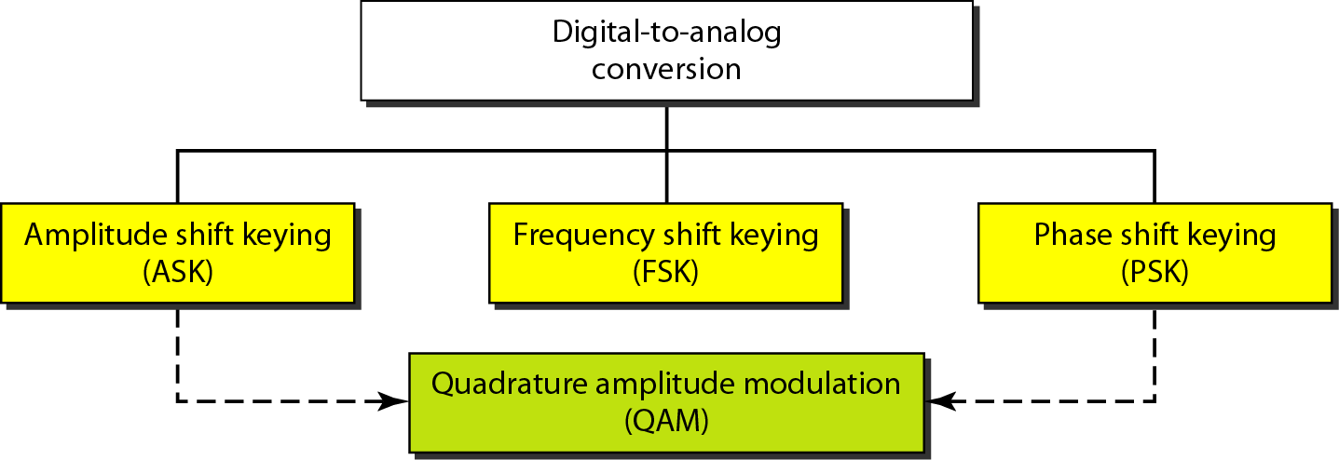
Digital Data, Analog Signal

Slide 23
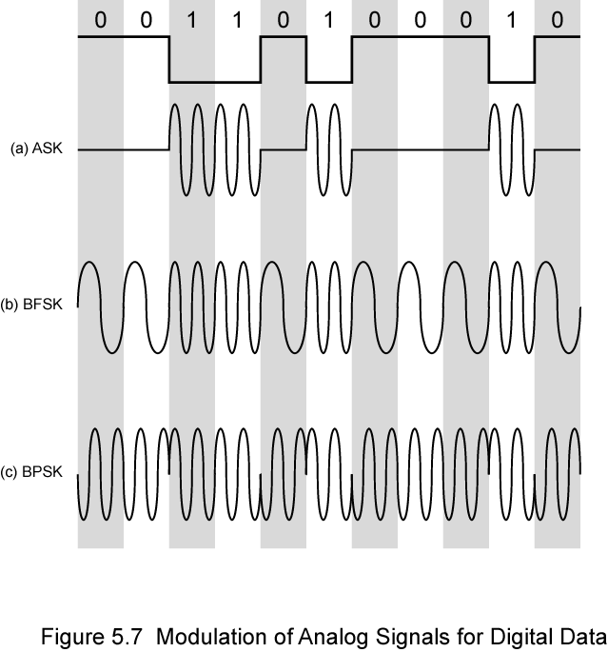
Modulation Techniques

Slide 24
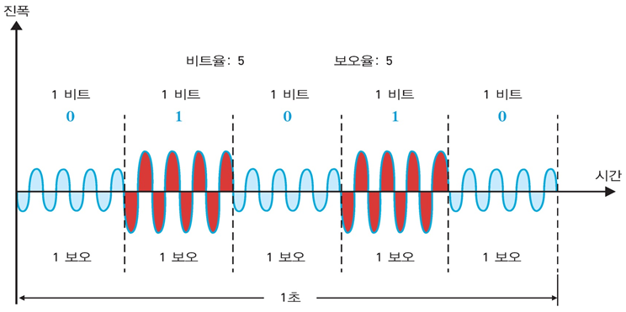
Amplitude Shift Keying
진폭 차이
주파수와 위상은 변하지 않음

Slide 25
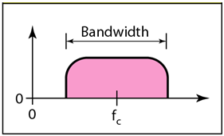
Amplitude Shift Keying
encode 0/1 by different carrier amplitudes
usually have one amplitude zero
presence and absence of carrier

Slide 26
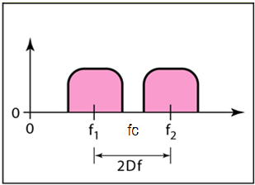
Binary Frequency Shift Keying
two binary values represented by two different frequencies (near and on both sides of a central carrier frequency f_{c})

Slide 27
FSK
Data
signal
vd(t)
Carrier 1
v1(t), f1
Carrier 2
v2(t), f2
vFSK(t)

Slide 28
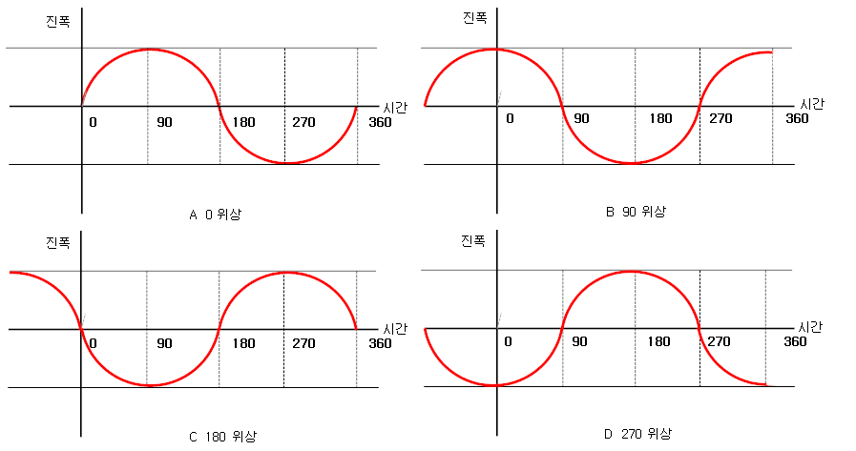
Phase Shift Keying
위상(Phase)
진동이나 파동과 같이 주기적으로 반복 되는 현상에 대해 어떤 시각 또는 어떤 지점에서의 변화의 상태
시각 0시에 대한 파형의 상대적인 위치

Slide 29
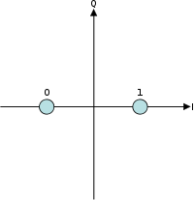
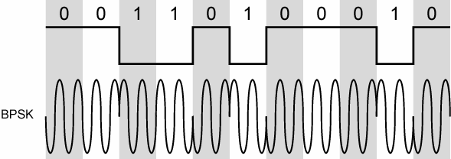
Phase Shift Keying
phase of carrier signal is shifted to represent data
Binary PSK (BPSK)
two phases (spaced at 180°) represent two binary digits

Slide 30
Quadrature Amplitude Modulation (QAM)
combination of ASK and PSK
improved data rate for given bandwidth
increased potential error rate

Slide 31
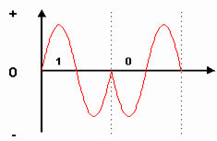
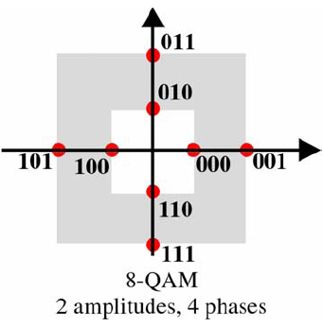
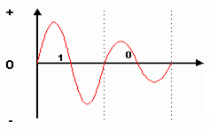
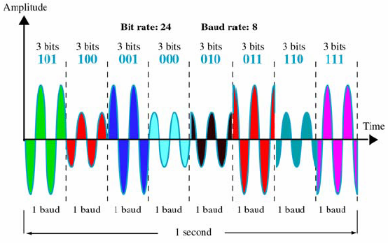
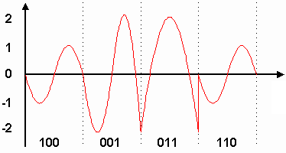
QAM Variants
Modulation of PSK
Modulation of ASK
QAM
8-QAM
ASK with 2 levels
PSK with 4 levels

Slide 32
M=256
M=128
M=64
M=32
M=16
M=4
+

Slide 33
Major 4 Encoding Methods
Digital Data
To
Digital Signal
Digital Data
To
Analog Signal
Analog Data
To
Digital Signal
Analog Data
To
Analog Signal

Slide 34
Analog Data, Digital Signal
digitization is conversion of analog data into digital data which can then:
be transmitted using Digital Data To Digital Signal encoding techniques
analog to digital conversion done using a codec
pulse code modulation (PCM)
delta modulation (DM)
…

Slide 35
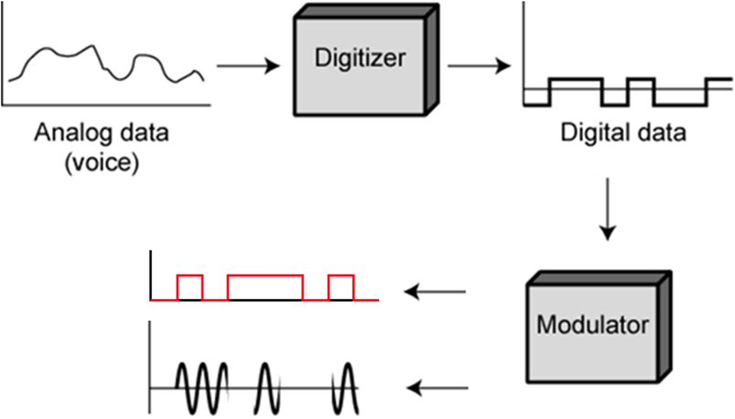
Digitizing Analog Data

Slide 36
Pulse Code Modulation (PCM)
Step1: Sampling (표본화)
Sample analog data at regular intervals
Pulse Amplitude Modulation (PAM)
Step2: Quantization (양자화)
Quantize PAM value
Step3: Binary Encoding (부호화)
Translate each value into n bit binary equivalent

Slide 37
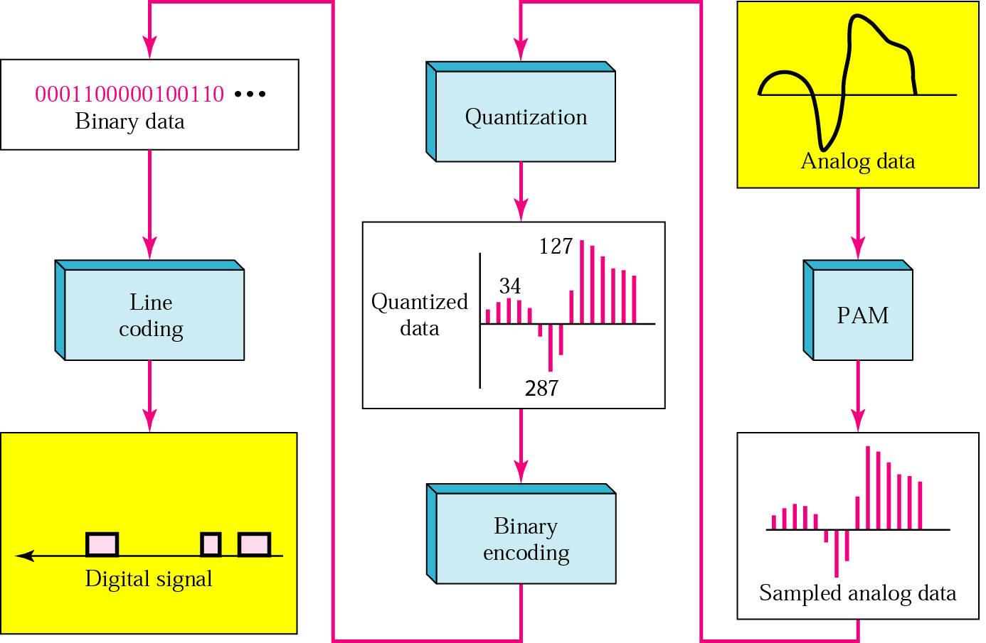

Slide 38
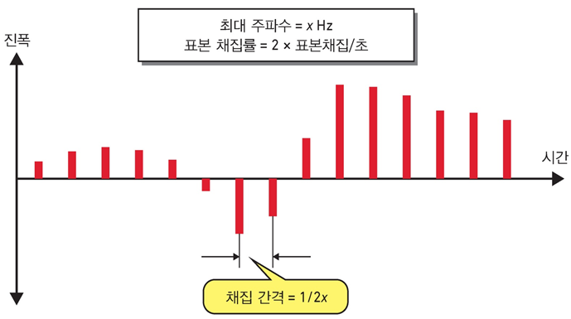
Pulse Code Modulation (PCM)
sampling theorem:
“If a signal is sampled at regular intervals at a rate higher than twice the highest signal frequency, the samples contain all information in original signal”
eg. 4000Hz voice data, requires 8000 sample per second

Slide 39
PCM 절차
양자화 비트 수 (Quantization Bit Depth): n
샘플된 값을 몇 개의 비트로 표현하는가를 나타냄
비트 수가 클수록 더 세밀하게 표현 가능
양자화 레벨 수 (Quantization Level Number): L
L = 2^{n}
최대 입력 범위 (Full Scale Range) / 동적 범위 (Dynamic Range): D
입력된 아날로그 신호 값의 최대 동적 범위
양자화 단위 (Quantization Step Size): δ
δ = D / L = D / 2^{n}

Slide 40
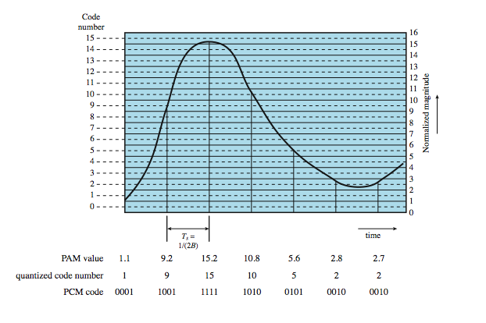
PCM Example

Slide 41
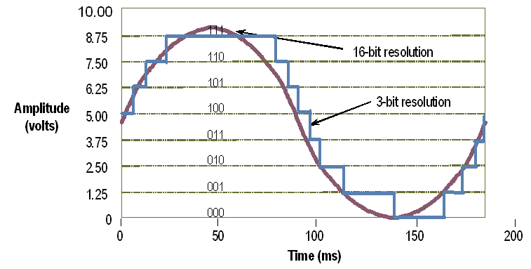
PCM Example

Slide 42
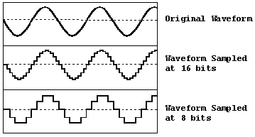
PCM Example

Slide 43
PCM Example
Bit Depth | Quality Level | Amplitude Values | Dynamic Range
8 bit | Telephony | 256 | 48.16dB
16 bit | Audio CD | 65,536 | 96.33dB
24 bit | Audio DVD | 16,777,216 | 144.49dB
32 bit | Best | 4,294,967,296 | 192.66dB
* MP3: 16 bit PCM
동적 범위 | - 일반적으로, 기기를 원하는 상태로 사용 가능한 동작범위 - 입력에서 주어질 수 있는 가장 큰 신호와 가장 작은 신호의 차이
마이크로폰 | 가장 작은 소리에서 가장 큰 소리까지 수음 범위 (약 140dB)
인간 청각 | 가장 작은 소리에서 가장 큰 소리까지 가청 범위 (약 120dB)
스피커 | 가장 작은 소리에서 가장 큰 소리까지 재생 범위

Slide 44
Major 4 Encoding Methods
Digital Data
To
Digital Signal
Digital Data
To
Analog Signal
Analog Data
To
Digital Signal
Analog Data
To
Analog Signal

Slide 45
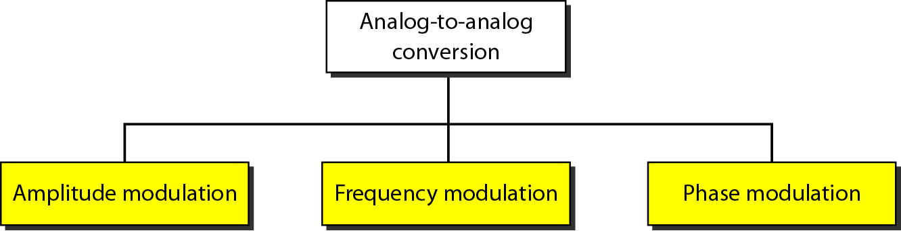
Analog Data, Analog Signals

Slide 46
Analog Data, Analog Signals
modulate carrier frequency with analog data
why modulate analog signals?
higher frequency can give more efficient transmission
permits frequency division multiplexing
types of modulation:
Amplitude modulation
Angle modulation
Frequency
Phase

Slide 47
Amplitude Modulation
The amplitude of high-carrier signal is varied according to the instantaneous amplitude of the modulating message signal m(t).

Slide 48
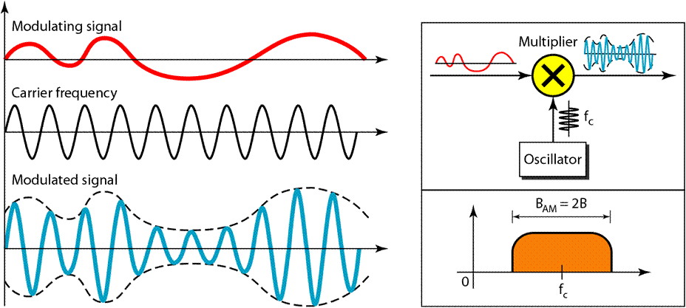
Amplitude Modulation

Slide 49
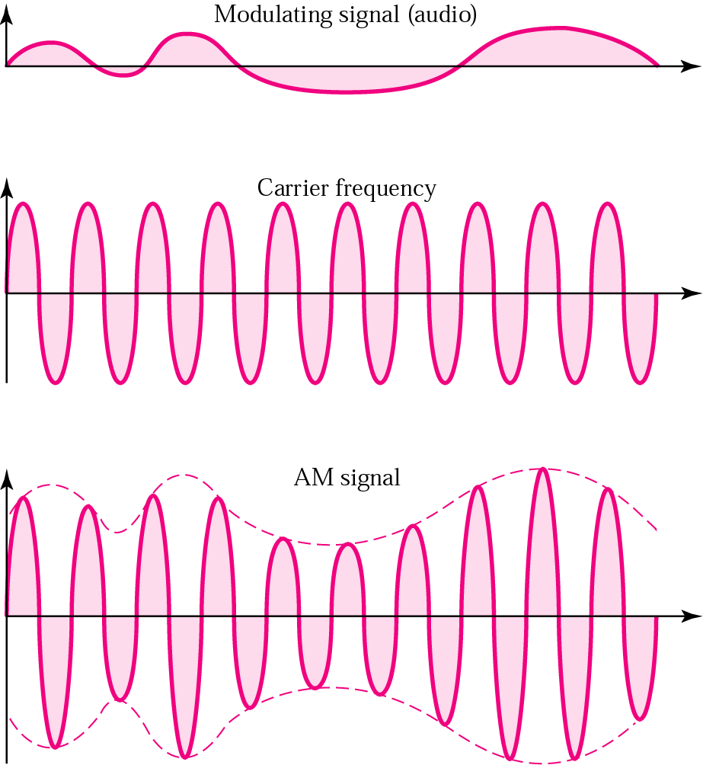
Amplitude Modulation

Slide 50
Amplitude Modulation
Diagram
A_{c} + m(t)
DC A_{c}
s(t)
Modulating
Signal m(t)
cos2πf_{c}t

Slide 51
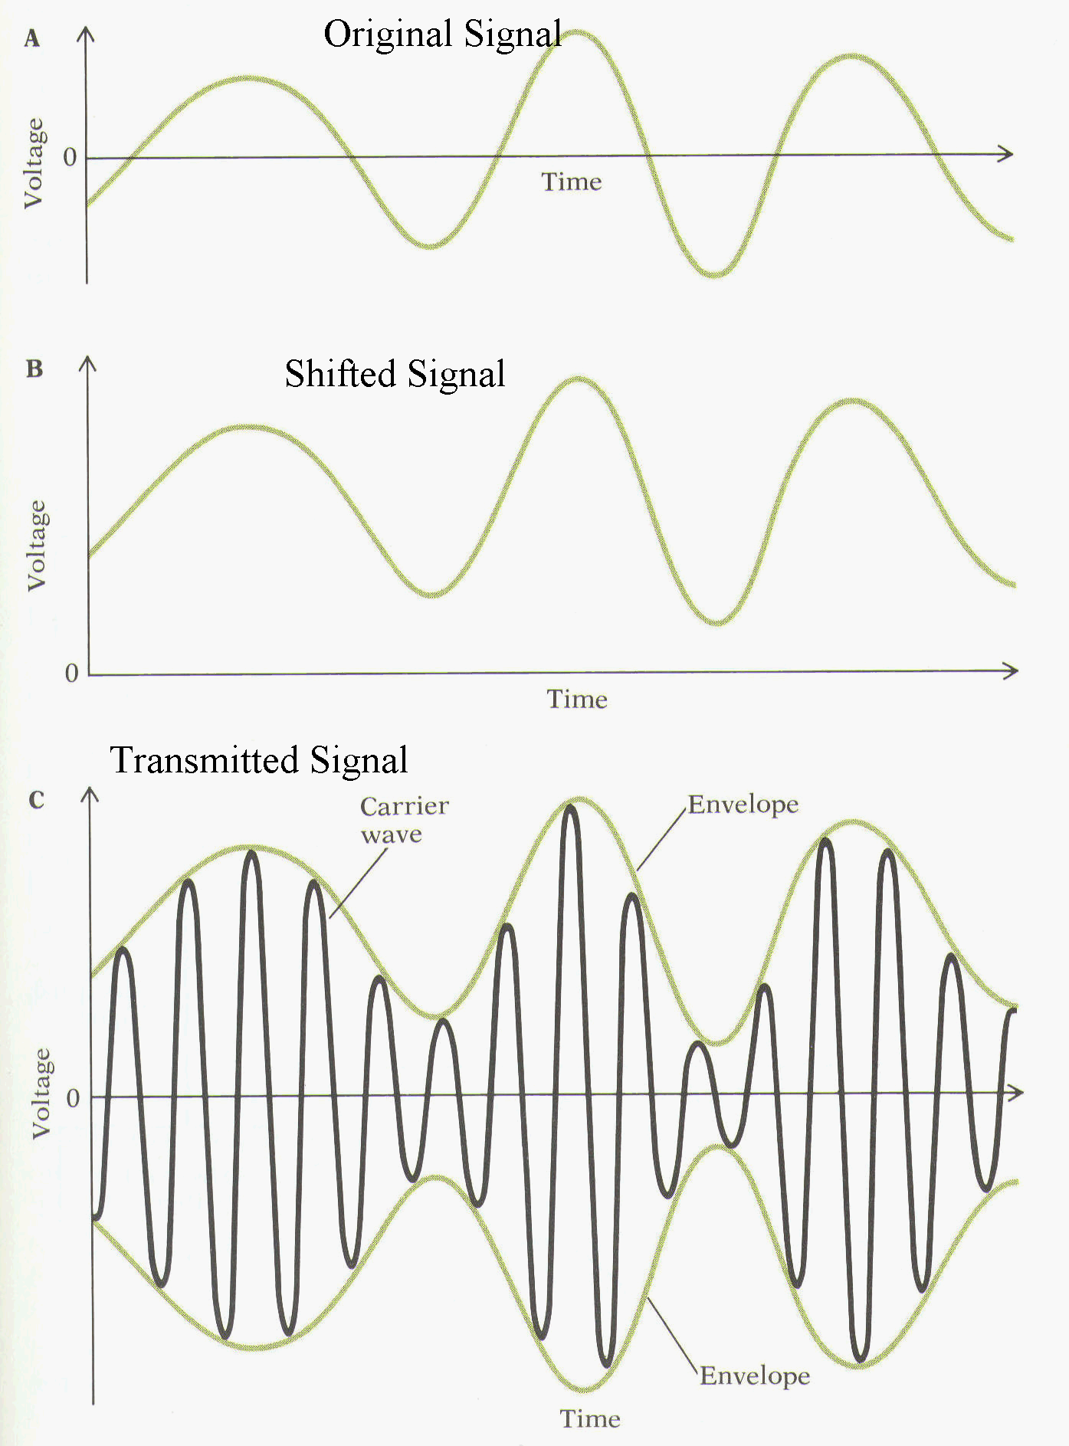
Amplitude Modulation
m(t)
A_{c} + m(t)
(A_{c} + m(t)) • cos2πf_{c}t

Slide 52
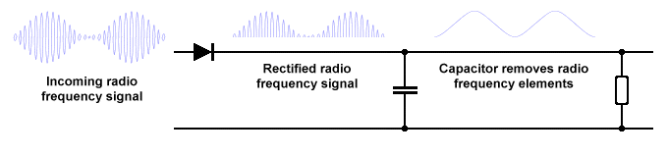
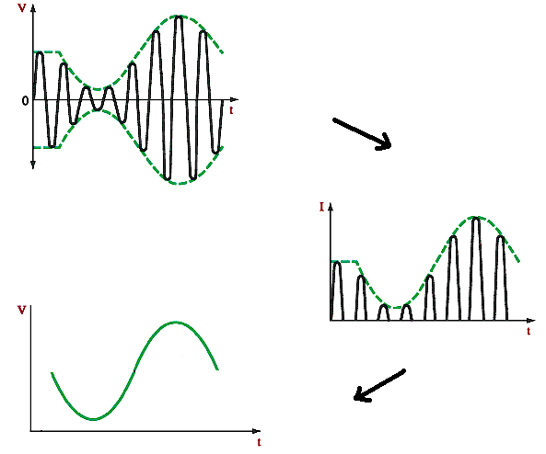
AM Demodulation

Slide 53
Angle Modulation
Angle modulation
Phase Modulation(PM)
Phase is proportional to modulating signal m(t)
n_{p} = phase modulation index in radians/volt
Frequency Modulation(FM)
Derivative of the phase is proportional to modulating signal m(t)
n_{f} = frequency modulation index in radians/volt

Slide 54
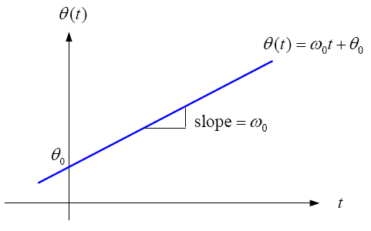
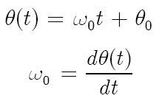


Angular Velocity
Since phase changes nonuniformly vs. time, we can define a rate of change
This is what we know as frequency

Slide 55
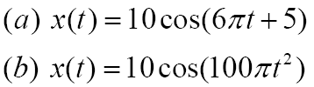
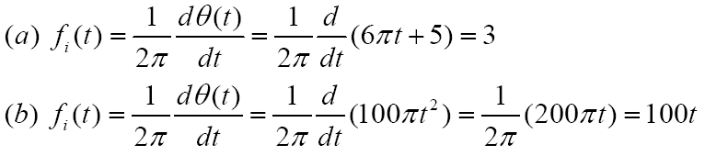
Example
Instantaneous frequency?
Solution

Slide 56

Phase Modulation(PM)
In PM, carrier angle changes linearly with the message
Instantaneous frequency

Slide 57

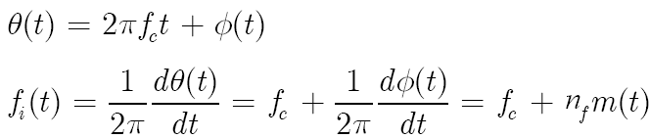
Frequency Modulation(FM)
In FM, it is the instantaneous frequency that varies linearly with message amplitude.
Modulated Signal
Instantaneous frequency

Slide 58
Illustrating FM & PM

Slide 59
FM Demodulation
Remember that message in an FM signal is in the instantaneous frequency or equivalently derivative of carrier angle
Do envelope detection on s’(t)

Slide 60
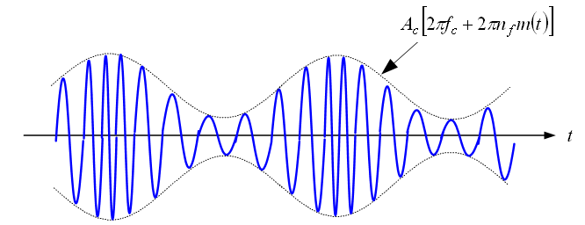
FM Demodulation
Waveform of the output signal (similar to AM demodulation)

